Slide 1




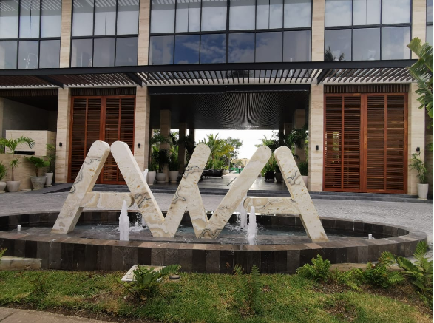

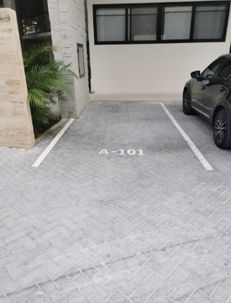
Welcome!
Thank you for booking AWA,
brought to you by Samson Waters
Name of Building: AWA
Unit Number: 101
Wi-Fi : AWA 101
Password: Wireless101
Location: Click Here for Google Map Location
BUILDING ARRIVAL
Welcome to AWA! Please follow these check in instructions for a smooth check in.
PARKING
If you have rented a vehicle, you have one spot available, its labeled A - 101.

Slide 2
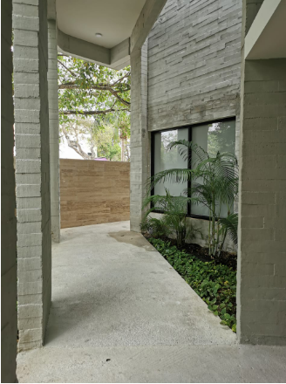
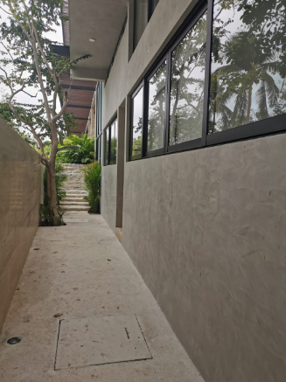
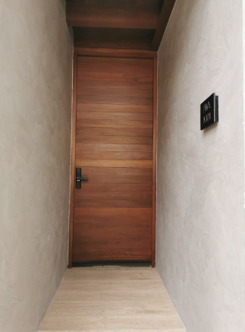
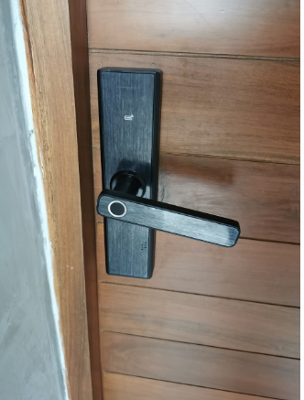
Once you have parked your vehicle, you will see a path on your left hand side. Follow the black arrows to arrive to your unit. Your unit A 101 will be on your right hand side.
Your unit uses a door code system, the code will be provided one day prior to your arrival.

Slide 3



PARKING
If you’ve driven a car to Playa, there is one parking space available for you, labeled A 101.
KEYS
Your unit uses a door code system, the code will be provided one day prior to your arrival.
Please let us know if there’s anything we can do to make your stay with us a wonderful, memorable stay. Tours, family excursions, private chefs are all available to be booked through me, your concierge.
Enjoy your stay!
Akumal ●Mérida ●Playa del Carmen ●Puerto Vallarta ●Tulum

