Slide 1




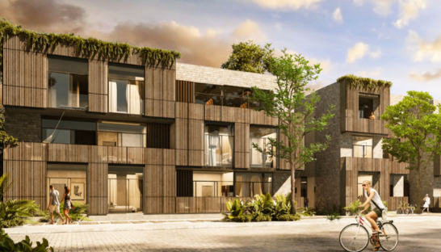

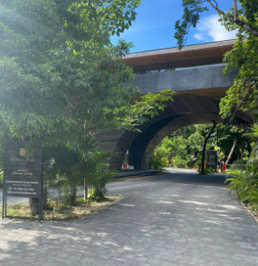
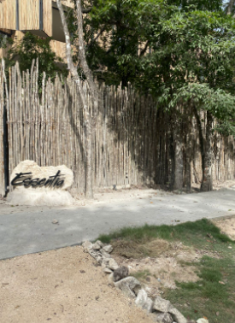
Welcome!
Thank you for booking Essentia, brought to you by Samson Waters
Name of Building: Essentia
Unit Number: 209B
Wi-Fi : Essentia-209B
Password: Welcomehome209
Location: Click here for the Google maps location
Welcome Essentia, please follow these simple instructions for a smooth check in!
If you have driven a car, you will find parking just in front. The spots are not assigned.
This is the MiraLuna main gate, once inside take a right and follow the road almost till the end. When you see the Essentia sign, you have arrived.

Slide 2
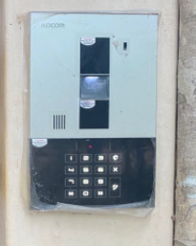
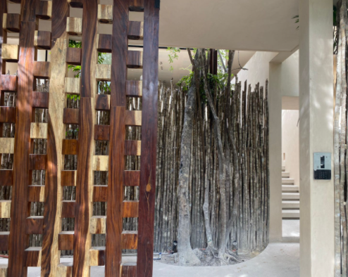
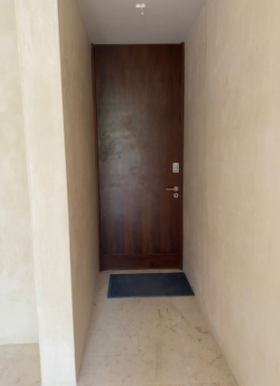
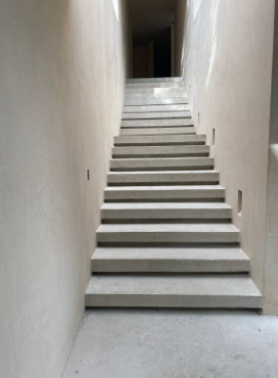
The main door uses a code system, the code will be provided to you from your concierge. When arriving to this point, turn right and take the stairs all the way up.
Your unit uses a door code system. The code will be provided one day prior to arrival.

Slide 3

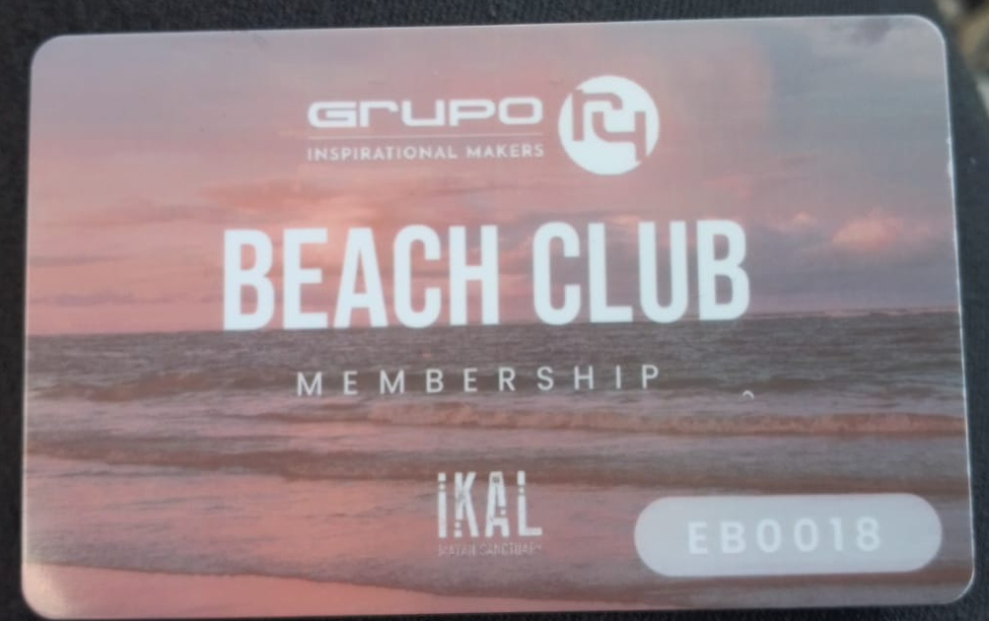
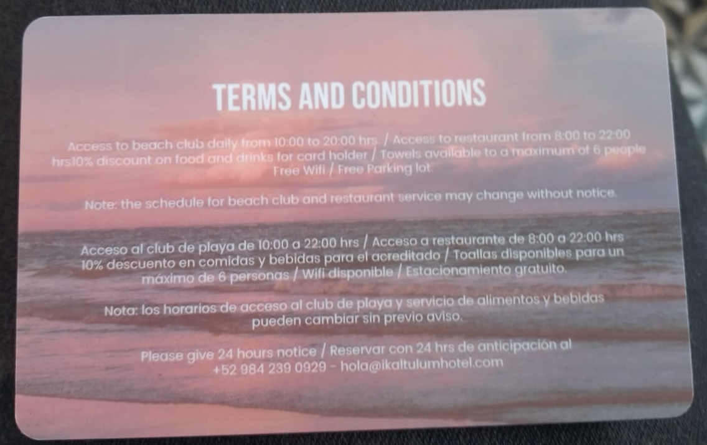
Your unit uses a door code system. The code will be provided one day prior to arrival.
En este condominio estamos
conscientes del impacto ecológico, por favor NO TIRES PAPEL,TOALLAS, PRODUCTOS SANITARIOS
E INORGÁNICOS AL WC para ayudarnos a evitar obstrucciones en el sistema de drenaje del departamento y del edificio.
Gracias!
Ïn this condo we care of the environment, please
DO NOT FLUSH toilet paper, sanitary products, tissues, femenine products, baby wipes, etc. This will be very helpful to keep the drain system free of blocks
Thank you!
You will find a beach club access card to enjoy during your stay, please place it before check out where you found it at check in. In case of lost, a replacement fee will be charge.

Slide 4




PARKING
If you’ve driven a car, there is one parking space available
KEYS
Your unit uses a door code system, the code will be provided one day prior to arrival.
Please let us know if there’s anything we can do to make your stay with us a wonderful, memorable stay, tours. Family excursions, private chefs are all available to be booked through me, your concierge.
Enjoy your stay!
Akumal ●Mérida ●Playa del Carmen ●Puerto Vallarta ●Tulum

