Slide 1




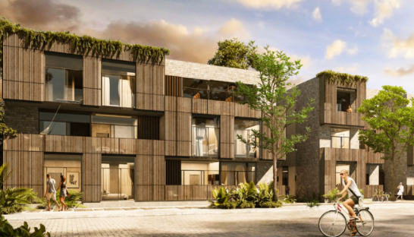

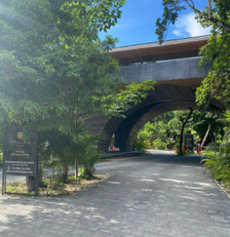
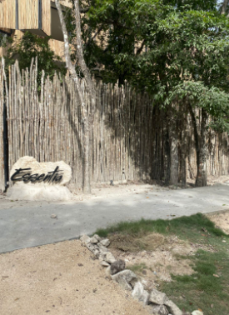
Welcome!
Thank you for booking Essentia, brought to you by Samson Waters
Name of Building: Essentia
Unit Number: 209B
Wi-Fi : Essentia-209B
Password: Welcomehome209
Location: Click here for the Google maps location
Welcome Essentia, please follow these simple instructions for a smooth check in!
If you have driven a car, you will find parking just in front. The spots are not assigned.
This is the MiraLuna main gate, once inside take a right and follow the road almost till the end. When you see the Essentia sign, you have arrived.

Slide 2
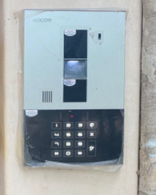
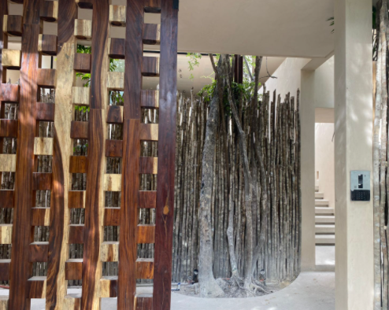
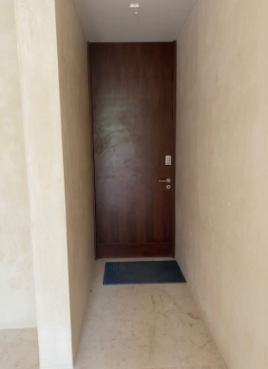
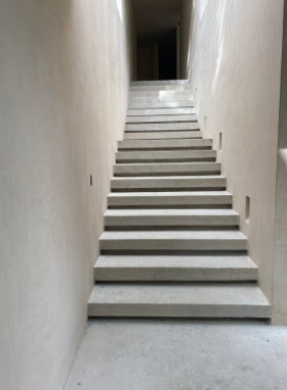
The main door uses a code system, the code will be provided to you from your concierge. When arriving to this point, turn right and take the stairs all the way up.
Your unit uses a door code system. The code will be provided one day prior to arrival.

Slide 3




PARKING
If you’ve driven a car, there is one parking space available
KEYS
Your unit uses a door code system, the code will be provided one day prior to arrival.
Please let us know if there’s anything we can do to make your stay with us a wonderful, memorable stay, tours. Family excursions, private chefs are all available to be booked through me, your concierge.
Enjoy your stay!
Akumal ●Mérida ●Playa del Carmen ●Puerto Vallarta ●Tulum

