Slide 1




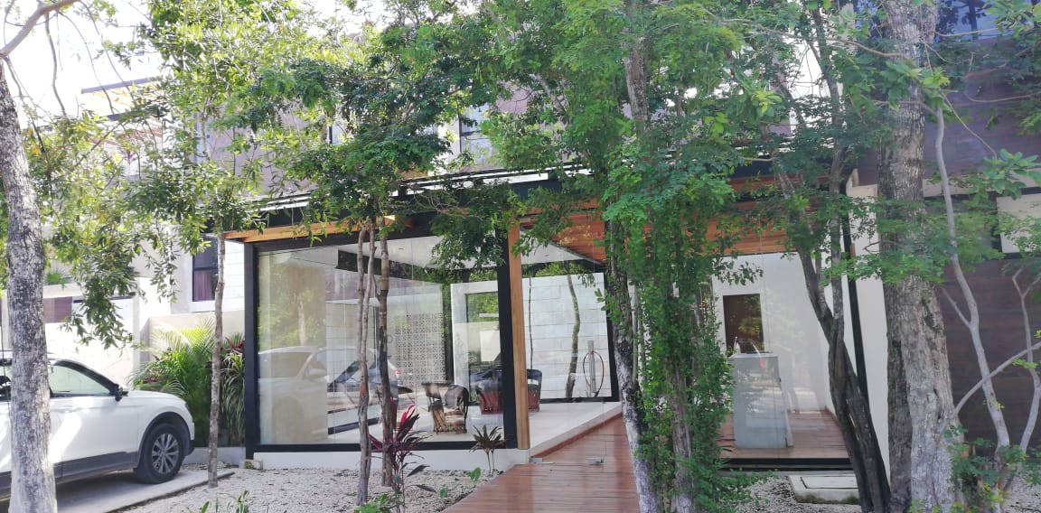

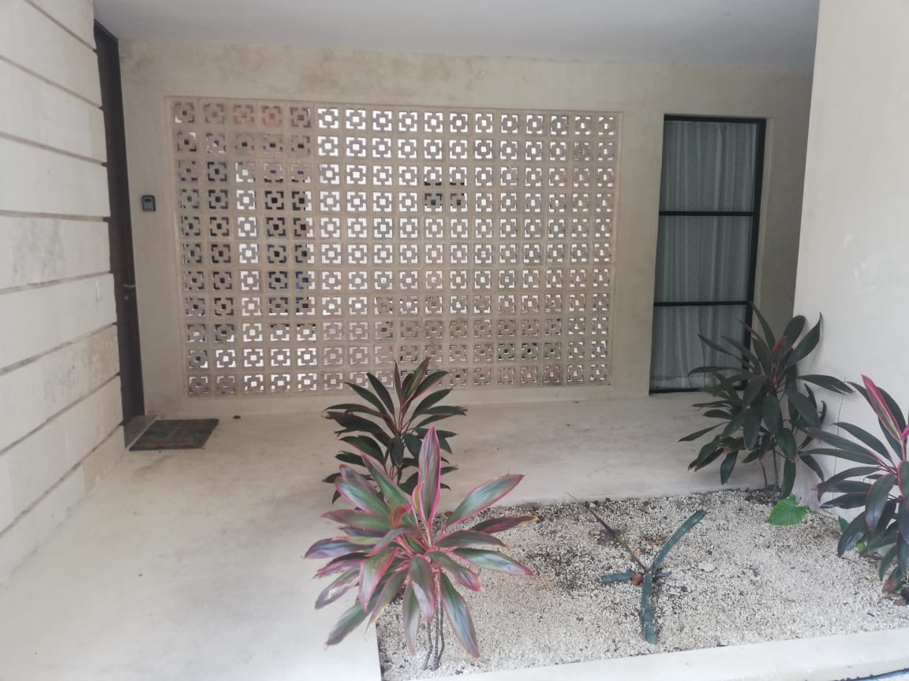
Welcome!
Thank you for booking Mareas Condos , brought to you by Samson Waters
Name of Building: Mareas Condos
Unit Number: 3A
Wi-Fi : INFINITUM0B63_5. o 2.4
Password: upTYFns3N7
Location:Click here for Google Map location
Welcome to Marea! Make sure you make a stop at the reception when arriving to sign in.
They will require your name, your check out date, and your unit number.
When passing the reception area, continue straight then go to your right.

Slide 2
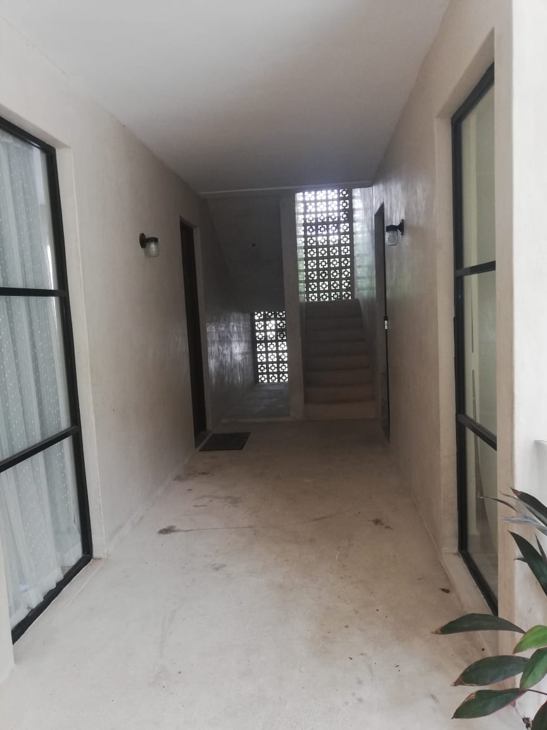
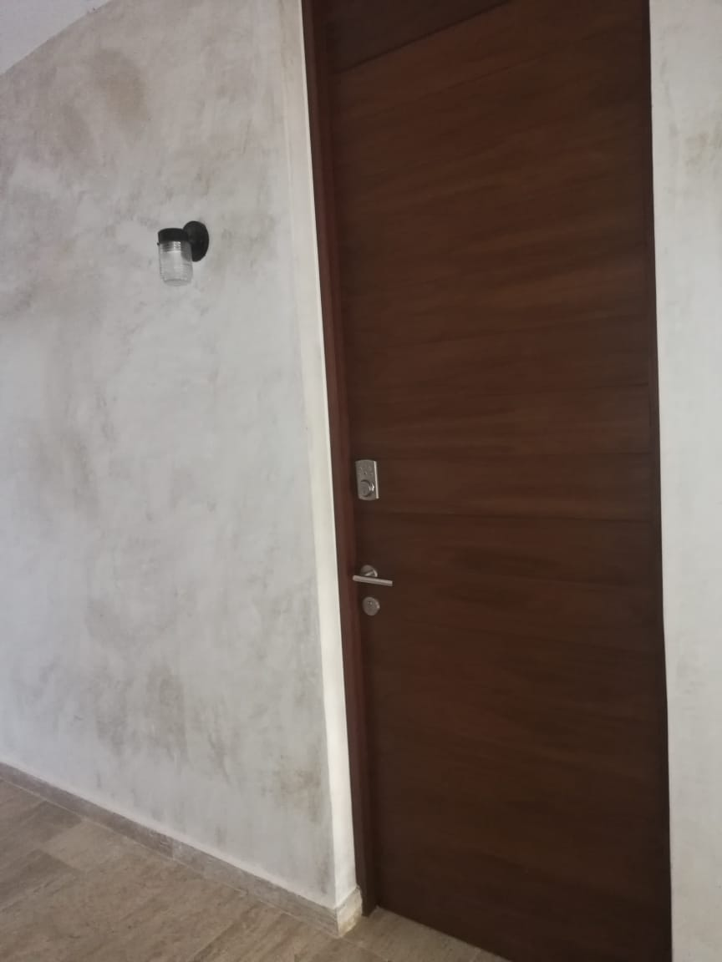
Continue walking down this hallway, take the stairs to the third floor.
Your unit 3A is the first door on your left hand side.
The unit uses a door code system to enter. You will see the keypad on the door. The code will be provided one day prior to your arrival.

Slide 3




PARKING
If you’ve driven a car, there is one parking space available
KEYS
Your unit uses a door code system, the code will be provided one day prior to arrival.
Please let us know if there’s anything we can do to make your stay with us a wonderful, memorable stay. Tours family excursions, private chefs are all available to be booked through me, your concierge.
Enjoy your stay!
Akumal ●Mérida ●Playa del Carmen ●Puerto Vallarta ●Tulum

