Slide 1




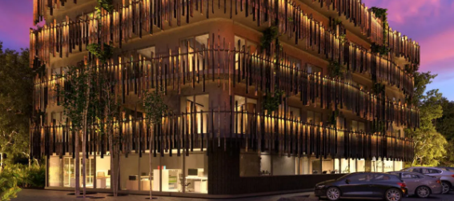

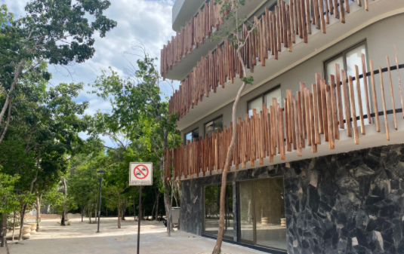
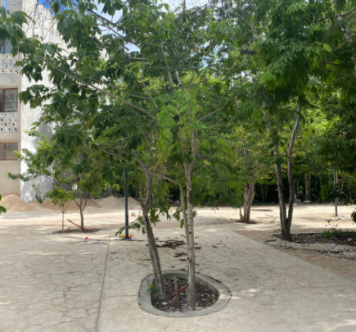
Welcome!
Thank you for booking Phimai, brought to you by Samson Waters
Name of Building: Phimai
Unit Number: 5
Wi-Fi : TP-Link_C272
Password: 22033529
Location: Click here for the Google maps location
Welcome Phimai, please follow these simple instructions for a smooth check in!
If you have driven a car, you will find parking just in front. The spots are not assigned.
This is the side of the Phimai building where you will find parking. Walk straight and turn to your right when you see this point.

Slide 2
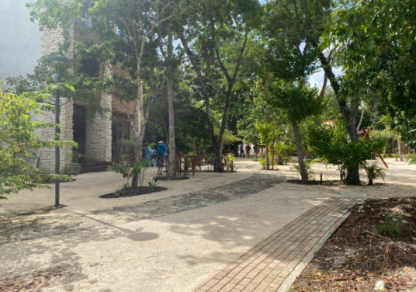
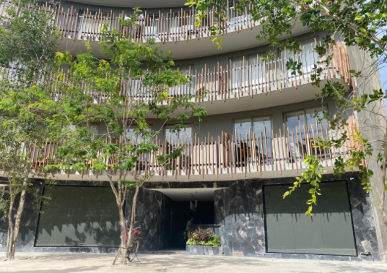

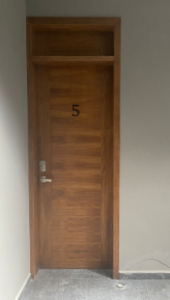
Once you have reach this point turn to your right and continue walking straight...
At this point you will arrive to main access of the Phimai building.
Once inside you will have to register at the reception. Once registered head up to the second floor, Your unit will be your right hand side. Your unit uses a door code system. The code will be provided one day prior to your arrival.

Slide 3




PARKING
If you’ve driven a car, there is one parking space available
KEYS
Your unit uses a door code system, the code will be provided one day prior to arrival.
Please let us know if there’s anything we can do to make your stay with us a wonderful, memorable stay, tours. Family excursions, private chefs are all available to be booked through me, your concierge.
Enjoy your stay!
Akumal ●Mérida ●Playa del Carmen ●Puerto Vallarta ●Tulum

